Slide 1
SOLR comparison stemming + synonyms

Slide 2
The algorithms
Running SOLR with same synonyms file on same datasets.
Change between algorithm versions is the schema file.
The first incorporates synonyms at index time
The second incorporates both synonyms and stemming at both index and query time.

Slide 3
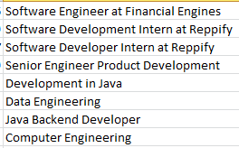
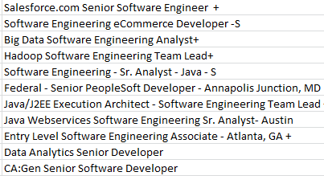
Testing on a dataset with all true positive matches
Candidates
Jobs
The candidates and jobs should all match, based on keywords and job names.

Slide 4
Algorithm results
The algorithm using only synonyms found 77% of the matches.
The algorithm using synonyms+ stemming found 100% of the matches.
So for synonyms + stemming we have reduced false negatives to 0 for this example.

Slide 5
More data
We run the algorithm on a larger data set.
Our aim is to see that SOLR with synonyms + stemming is able to find more matches than SOLR with only synonyms.
Incorporating stemming should cast a wider net and find more matches, and to validate this we look to see that it’s finding more matches than previous SOLR algorithm
We augment the true matches data set with more job and candidate data and run both algorithms.

Slide 6
Larger Dataset
SOLR with synonyms + stemming found 10% more matches than SOLR with only synonyms.
Of these matches found in SOLR with stemming, 95% of them were true positives
ie. Matches like recruitment -> talent sourcing that weren’t being found before

Slide 7
Examples
A good example is how a person with the title “Recruitment” matches to the job “Sourcing manager, HR”.
Although ‘recruiter’ and ‘sourcing’ are synonyms, the stemmed versions are not equated in old version of SOLR and this match would not show up otherwise.
We also have a person whose title is ‘Development in Java’ matching to a job ‘Java/J2EE Execution Architect - Software Engineering Team Lead’
Here ‘engineering’ and ‘development’ are matching, even though synonym terms are ‘engineer’ and ‘developer’.
We see stemming + synonyms actually casts a wider net

Slide 8
Next Steps
SOLR with stemming +synonyms casts a wider net to catch more terms, but it does not necessarily work to reduce number of false positive matches, ie. Matches that show up that shouldn’t.
We must use this in conjunction with other methods, such as finely tuning synonyms, higher order language recognition algorithms, etc. in order to continue to improve the algorithm

